Slide 1


Slide 2

Chapter 17
Introduction to Transaction Processing Concepts and Theory
Copyright © 2004 Pearson Education, Inc.

Slide 3
Chapter Outline
1 Introduction to Transaction Processing
2 Transaction and System Concepts
3 Desirable Properties of Transactions
Transaction Support in SQL
Locking techniques
Chapter 17-<number>

Slide 4
1 Introduction to Transaction Processing (1)
Single-User System: At most one user at a time can use the system.
Multiuser System: Many users can access the system concurrently.
Concurrency
  Interleaved processing: concurrent execution of processes is interleaved in a single CPU
  Parallel processing: processes are concurrently executed in multiple CPUs.
Chapter 17-<number>

Slide 5
Introduction to Transaction Processing (2)
A Transaction: logical unit of database processing that includes one or more access operations (read -retrieval, write - insert or update, delete).
A transaction (set of operations) may be stand-alone specified in a high level language like SQL submitted interactively, or may be embedded within a program.
Transaction boundaries: Begin and End transaction.
An application program may contain several transactions separated by the Begin and End transaction boundaries.
Chapter 17-<number>

Slide 6
Introduction to Transaction Processing (3)
SIMPLE MODEL OF A DATABASE (for purposes of discussing transactions):
A database - collection of named data items
Granularity of data - a field, a record , or a whole disk block (Concepts are independent of granularity)
Basic operations are read and write
  read_item(X): Reads a database item named X into a program variable. To simplify our notation, we assume that the program variable is also named X.
  write_item(X): Writes the value of program variable X into the database item named X.
Chapter 17-<number>

Slide 7
Introduction to Transaction Processing (4)
READ AND WRITE OPERATIONS:
Basic unit of data transfer from the disk to the computer main memory is one block. In general, a data item (what is read or written) will be the field of some record in the database, although it may be a larger unit such as a record or even a whole block.
read_item(X) command includes the following steps:
Find the address of the disk block that contains item X.
Copy that disk block into a buffer in main memory (if that disk block is not already in some main memory buffer).
Copy item X from the buffer to the program variable named X.
Chapter 17-<number>

Slide 8
Introduction to Transaction Processing (5)
READ AND WRITE OPERATIONS (cont.):
write_item(X) command includes the following steps:
Find the address of the disk block that contains item X.
Copy that disk block into a buffer in main memory (if that disk block is not already in some main memory buffer).
Copy item X from the program variable named X into its correct location in the buffer.
Store the updated block from the buffer back to disk (either immediately or at some later point in time).
Chapter 17-<number>

Slide 9

FIGURE 17.2
Two sample transactions. (a) Transaction T₁.
(b) Transaction T₂.
Chapter 17-<number>

Slide 10
Introduction to Transaction Processing (7)
Why Concurrency Control is needed:
The Lost Update Problem.
This occurs when two transactions that access the same database items have their operations interleaved in a way that makes the value of some database item incorrect.
The Temporary Update (or Dirty Read) Problem.
This occurs when one transaction updates a database item and then the transaction fails for some reason (see Section 17.1.4). The updated item is accessed by another transaction before it is changed back to its original value.
Chapter 17-<number>

Slide 11
Introduction to Transaction Processing (8)
Why Concurrency Control is needed (cont.):
The Incorrect Summary Problem .
If one transaction is calculating an aggregate summary function on a number of records while other transactions are updating some of these records, the aggregate function may calculate some values before they are updated and others after they are updated.
Chapter 17-<number>

Slide 12
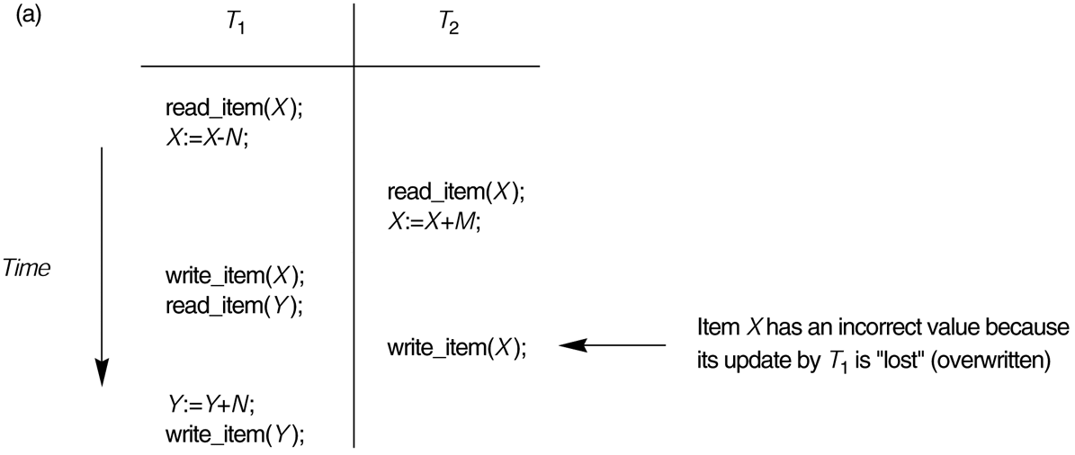
FIGURE 17.3
Some problems that occur when concurrent execution is uncontrolled. (a) The lost update problem.
Chapter 17-<number>

Slide 13
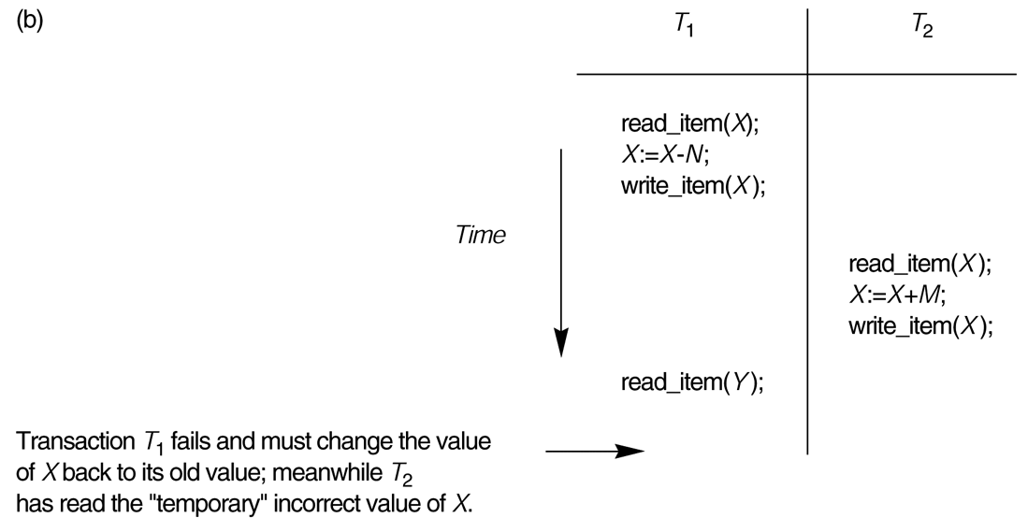
FIGURE 17.3 (continued)
Some problems that occur when concurrent execution is uncontrolled. (b) The temporary update problem.
Chapter 17-<number>

Slide 14
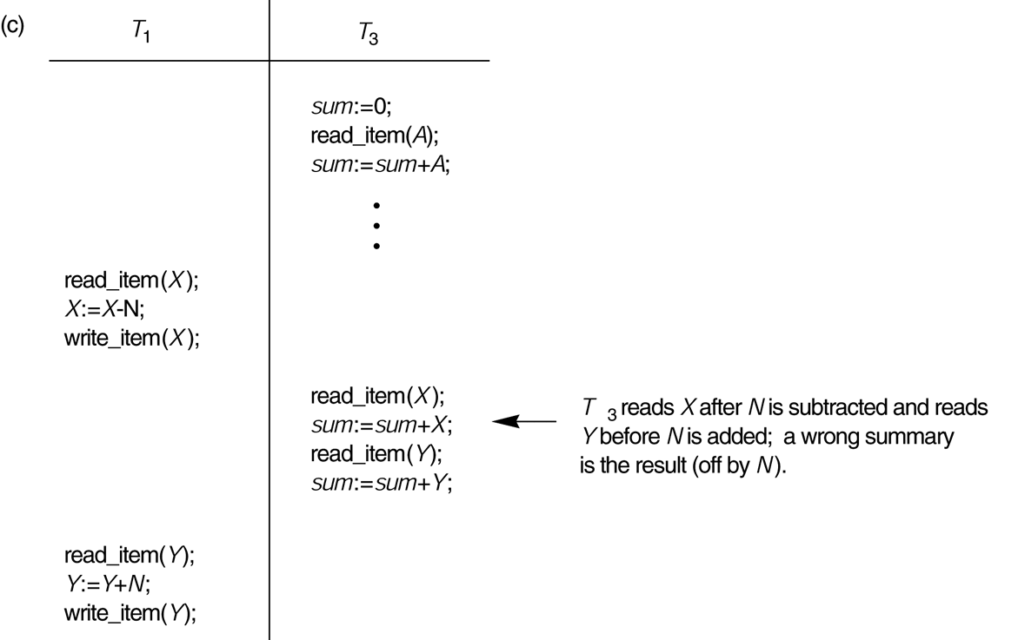
FIGURE 17.3 (continued)
Some problems that occur when concurrent execution is uncontrolled. (c) The incorrect summary problem.
Chapter 17-<number>

Slide 15
Introduction to Transaction Processing (11)
Why recovery is needed:
(What causes a Transaction to fail)
1. A computer failure (system crash): A hardware or software error occurs in the computer system during transaction execution. If the hardware crashes, the contents of the computer’s internal memory may be lost.
2. A transaction or system error : Some operation in the transaction may cause it to fail, such as integer overflow or division by zero. Transaction failure may also occur because of erroneous parameter values or because of a logical programming error. In addition, the user may interrupt the transaction during its execution.
Chapter 17-<number>

Slide 16
Introduction to Transaction Processing (12)
Why recovery is needed (cont.):
3. Local errors or exception conditions detected by the transaction:
- certain conditions necessitate cancellation of the transaction. For example, data for the transaction may not be found. A condition, such as insufficient account balance in a banking database, may cause a transaction, such as a fund withdrawal from that account, to be canceled.
- a programmed abort in the transaction causes it to fail.
4. Concurrency control enforcement: The concurrency control method may decide to abort the transaction, to be restarted later, because it violates serializability or because several transactions are in a state of deadlock (see Chapter 18).
Chapter 17-<number>

Slide 17
Introduction to Transaction Processing (13)
Why recovery is needed (cont.):
5. Disk failure: Some disk blocks may lose their data because of a read or write malfunction or because of a disk read/write head crash. This may happen during a read or a write operation of the transaction.
6. Physical problems and catastrophes: This refers to an endless list of problems that includes power or air-conditioning failure, fire, theft, sabotage, overwriting disks or tapes by mistake, and mounting of a wrong tape by the operator.
Chapter 17-<number>

Slide 18
2 Transaction and System Concepts (1)
A transaction is an atomic unit of work that is either completed in its entirety or not done at all. For recovery purposes, the system needs to keep track of when the transaction starts, terminates, and commits or aborts.
Transaction states:
Active state
Partially committed state
Committed state
Failed state
Terminated State
Chapter 17-<number>

Slide 19
Transaction and System Concepts (2)
Recovery manager keeps track of the following operations:
begin_transaction: This marks the beginning of transaction execution.
read or write: These specify read or write operations on the database items that are executed as part of a transaction.
end_transaction: This specifies that read and write transaction operations have ended and marks the end limit of transaction execution. At this point it may be necessary to check whether the changes introduced by the transaction can be permanently applied to the database or whether the transaction has to be aborted because it violates concurrency control or for some other reason.
Chapter 17-<number>

Slide 20
Transaction and System Concepts (3)
Recovery manager keeps track of the following operations (cont):
commit_transaction: This signals a successful end of the transaction so that any changes (updates) executed by the transaction can be safely committed to the database and will not be undone.
rollback (or abort): This signals that the transaction has ended unsuccessfully, so that any changes or effects that the transaction may have applied to the database must be undone.
Chapter 17-<number>

Slide 21
Transaction and System Concepts (4)
Recovery techniques use the following operators:
undo: Similar to rollback except that it applies to a single operation rather than to a whole transaction.
redo: This specifies that certain transaction operations must be redone to ensure that all the operations of a committed transaction have been applied successfully to the database.
Chapter 17-<number>

Slide 22
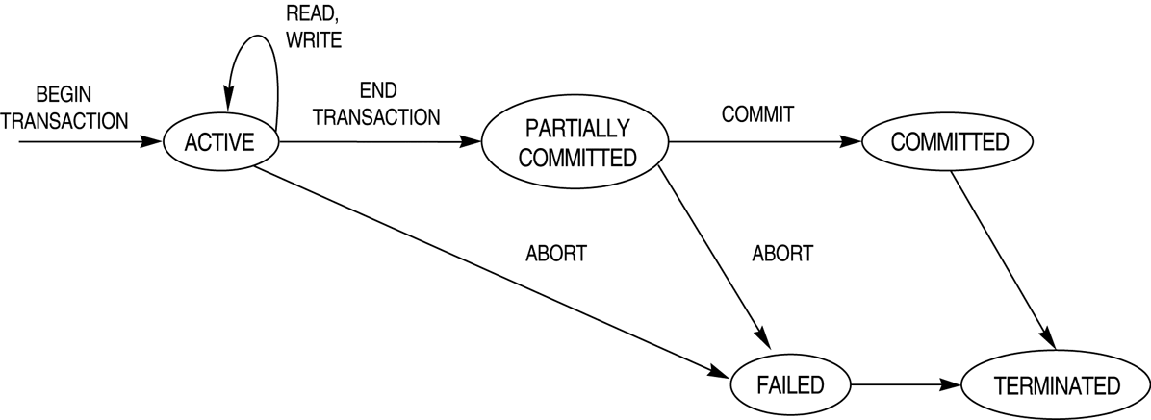
FIGURE 17.4
State transition diagram illustrating the states for transaction execution.
Chapter 17-<number>

Slide 23
Transaction and System Concepts (6)
The System Log
Log or Journal : The log keeps track of all transaction operations that affect the values of database items. This information may be needed to permit recovery from transaction failures. The log is kept on disk, so it is not affected by any type of failure except for disk or catastrophic failure. In addition, the log is periodically backed up to archival storage (tape) to guard against such catastrophic failures.
T in the following discussion refers to a unique transaction-id that is generated automatically by the system and is used to identify each transaction:
Chapter 17-<number>

Slide 24
Transaction and System Concepts (7)
The System Log (cont):
Types of log record:
[start_transaction,T]: Records that transaction T has started execution.
[write_item,T,X,old_value,new_value]: Records that transaction T has changed the value of database item X from old_value to new_value.
[read_item,T,X]: Records that transaction T has read the value of database item X.
[commit,T]: Records that transaction T has completed successfully, and affirms that its effect can be committed (recorded permanently) to the database.
[abort,T]: Records that transaction T has been aborted.
Chapter 17-<number>

Slide 25
Transaction and System Concepts (8)
The System Log (cont):
protocols for recovery that avoid cascading rollbacks do not require that read operations be written to the system log, whereas other protocols require these entries for recovery.
strict protocols require simpler write entries that do not include new_value (see Section 17.4).
Chapter 17-<number>

Slide 26
Transaction and System Concepts (9)
Recovery using log records:
If the system crashes, we can recover to a consistent database state by examining the log and using one of the techniques described in Chapter 19.
Because the log contains a record of every write operation that changes the value of some database item, it is possible to undo the effect of these write operations of a transaction T by tracing backward through the log and resetting all items changed by a write operation of T to their old_values.
We can also redo the effect of the write operations of a transaction T by tracing forward through the log and setting all items changed by a write operation of T (that did not get done permanently) to their new_values.
Chapter 17-<number>

Slide 27
Transaction and System Concepts (10)
Commit Point of a Transaction:
Definition: A transaction T reaches its commit point when all its operations that access the database have been executed successfully and the effect of all the transaction operations on the database has been recorded in the log. Beyond the commit point, the transaction is said to be committed, and its effect is assumed to be permanently recorded in the database. The transaction then writes an entry [commit,T] into the log.
Roll Back of transactions: Needed for transactions that have a [start_transaction,T] entry into the log but no commit entry [commit,T] into the log.
Chapter 17-<number>

Slide 28
Transaction and System Concepts (11)
Commit Point of a Transaction (cont):
Redoing transactions: Transactions that have written their commit entry in the log must also have recorded all their write operations in the log; otherwise they would not be committed, so their effect on the database can be redone from the log entries. (Notice that the log file must be kept on disk. At the time of a system crash, only the log entries that have been written back to disk are considered in the recovery process because the contents of main memory may be lost.)
Force writing a log: before a transaction reaches its commit point, any portion of the log that has not been written to the disk yet must now be written to the disk. This process is called force-writing the log file before committing a transaction.
Chapter 17-<number>

Slide 29
3 Desirable Properties of Transactions (1)
ACID properties:
Atomicity: A transaction is an atomic unit of processing; it is either performed in its entirety or not performed at all.
Consistency preservation: A correct execution of the transaction must take the database from one consistent state to another.
Chapter 17-<number>

Slide 30
Desirable Properties of Transactions (2)
ACID properties (cont.):
Isolation: A transaction should not make its updates visible to other transactions until it is committed; this property, when enforced strictly, solves the temporary update problem and makes cascading rollbacks of transactions unnecessary (see Chapter 21).
Durability or permanency: Once a transaction changes the database and the changes are committed, these changes must never be lost because of subsequent failure.
Chapter 17-<number>

Slide 31
6 Transaction Support in SQL2 (1)
A single SQL statement is always considered to be atomic. Either the statement completes execution without error or it fails and leaves the database unchanged.
With SQL, there is no explicit Begin Transaction statement. Transaction initiation is done implicitly when particular SQL statements are encountered.
Every transaction must have an explicit end statement, which is either a COMMIT or ROLLBACK.
Chapter 17-<number>

Slide 32
Transaction Support in SQL2 (2)
Characteristics specified by a SET TRANSACTION statement in SQL2:
Access mode: READ ONLY or READ WRITE. The default is READ WRITE unless the isolation level of READ UNCOMITTED is specified, in which case READ ONLY is assumed.
Diagnostic size n, specifies an integer value n, indicating the number of conditions that can be held simultaneously in the diagnostic area. (Supply user feedback information)
Chapter 17-<number>

Slide 33
Transaction Support in SQL2 (3)
Characteristics specified by a SET TRANSACTION statement in SQL2 (cont.):
Isolation level <isolation>, where <isolation> can be READ UNCOMMITTED, READ COMMITTED, REPEATABLE READ or SERIALIZABLE. The default is SERIALIZABLE.
With SERIALIZABLE: the interleaved execution of transactions will adhere to our notion of serializability. However, if any transaction executes at a lower level, then serializability may be violated.
Chapter 17-<number>

Slide 34
Transaction Support in SQL2 (4)
Potential problem with lower isolation levels:
Dirty Read: Reading a value that was written by a transaction which failed.
Nonrepeatable Read: Allowing another transaction to write a new value between multiple reads of one transaction.
A transaction T1 may read a given value from a table. If another transaction T2 later updates that value and T1 reads that value again, T1 will see a different value. Consider that T1 reads the employee salary for Smith. Next, T2 updates the salary for Smith. If T1 reads Smith's salary again, then it will see a different value for Smith's salary.
Chapter 17-<number>

Slide 35
Transaction Support in SQL2 (5)
Potential problem with lower isolation levels (cont.):
Phantoms: New rows being read using the same read with a condition.
A transaction T1 may read a set of rows from a table, perhaps based on some condition specified in the SQL WHERE clause. Now suppose that a transaction T2 inserts a new row that also satisfies the WHERE clause condition of T1, into the table used by T1. If T1 is repeated, then T1 will see a row that previously did not exist, called a phantom.
Chapter 17-<number>

Slide 36
Transaction Support in SQL2 (6)
Sample SQL transaction:
EXEC SQL whenever sqlerror go to UNDO;
EXEC SQL SET TRANSACTION
READ WRITE
DIAGNOSTICS SIZE 5
ISOLATION LEVEL SERIALIZABLE;
EXEC SQL INSERT
INTO EMPLOYEE (FNAME, LNAME, SSN, DNO, SALARY)
VALUES ('Robert','Smith','991004321',2,35000);
EXEC SQL UPDATE EMPLOYEE
SET SALARY = SALARY * 1.1
WHERE DNO = 2;
EXEC SQL COMMIT;
GOTO THE_END;
UNDO: EXEC SQL ROLLBACK;
THE_END: ...
Chapter 17-<number>

Slide 37
Transaction Support in SQL2 (7)
Possible violation of serializabilty:
Type of Violation
___________________________________
Isolation Dirty nonrepeatable
level read read phantom
_____________________ _____ _________ ____________________
READ UNCOMMITTED yes yes yes
READ COMMITTED no yes yes
REPEATABLE READ no no yes
SERIALIZABLE no no no
Chapter 17-<number>

Slide 38
Database Concurrency Control
1 Purpose of Concurrency Control
    To enforce Isolation (through mutual exclusion) among conflicting transactions.
    To preserve database consistency through consistency preserving execution of transactions.
    To resolve read-write and write-write conflicts.
  Example: In concurrent execution environment if T1 conflicts with T2 over a data item A, then the existing concurrency control decides if T1 or T2 should get the A and if the other transaction is rolled-back or waits.
Chapter 18-<number>

Slide 39
Database Concurrency Control
Two-Phase Locking Techniques
  Locking is an operation which secures (a) permission to Read or (b) permission to Write a data item for a transaction. Example: Lock (X). Data item X is locked in behalf of the requesting transaction.
  Unlocking is an operation which removes these permissions from the data item. Example: Unlock (X). Data item X is made available to all other transactions.
  Lock and Unlock are Atomic operations.
Chapter 18-<number>

Slide 40
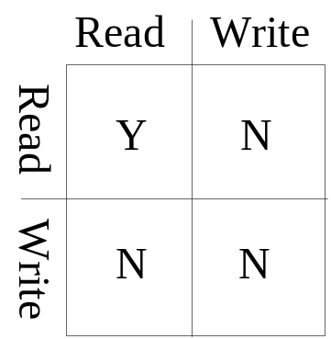
Database Concurrency Control
Two-Phase Locking Techniques: Essential components
Two locks modes (a) shared (read) and (b) exclusive (write).
  Shared mode: shared lock (X). More than one transaction can apply share lock on X for reading its value but no write lock can be applied on X by any other transaction.
  Exclusive mode: Write lock (X). Only one write lock on X can exist at any time and no shared lock can be applied by any other transaction on X.
  Conflict matrix
Chapter 18-<number>

Slide 41

Database Concurrency Control
Two-Phase Locking Techniques: Essential components
  Lock Manager: Managing locks on data items.
  Lock table: Lock manager uses it to store the identify of transaction locking a data item, the data item, lock mode and pointer to the next data item locked. One simple way to implement a lock table is through linked list.
Chapter 18-<number>

Slide 42
Database Concurrency Control
Two-Phase Locking Techniques: Essential components
  Database requires that all transactions should be well-formed. A transaction is well-formed if:
It must lock the data item before it reads or writes to it.
It must not lock an already locked data items and it must not try to unlock a free data item.
Chapter 18-<number>

Slide 43
Database Concurrency Control
Two-Phase Locking Techniques: Essential components
  The following code performs the lock operation:
  B: if LOCK (X) = 0 (*item is unlocked*)
  then LOCK (X) ← 1 (*lock the item*)
  else begin
  wait (until lock (X) = 0) and
  the lock manager wakes up the transaction);
  goto B
  end;
Chapter 18-<number>

Slide 44
Database Concurrency Control
Two-Phase Locking Techniques: Essential components
  The following code performs the unlock operation:
  LOCK (X) ← 0 (*unlock the item*)
  if any transactions are waiting then
  wake up one of the waiting the transactions;
Chapter 18-<number>

Slide 45
Database Concurrency Control
Two-Phase Locking Techniques: Essential components
The following code performs the read operation:
B: if LOCK (X) = “unlocked” then
  begin LOCK (X) ← “read-locked”;
  no_of_reads (X) ← 1;
  end
  else if LOCK (X) ← “read-locked” then
  no_of_reads (X) ← no_of_reads (X) +1
  else begin wait (until LOCK (X) = “unlocked” and
  the lock manager wakes up the transaction);
  go to B
  end;
Chapter 18-<number>

Slide 46
Database Concurrency Control
Two-Phase Locking Techniques: Essential components
The following code performs the write lock operation:
B: if LOCK (X) = “unlocked” then
  begin LOCK (X) ← “read-locked”;
  no_of_reads (X) ← 1;
  end
  else if LOCK (X) ← “read-locked” then
  no_of_reads (X) ← no_of_reads (X) +1
  else begin wait (until LOCK (X) = “unlocked” and
  the lock manager wakes up the transaction);
  go to B
  end;
Chapter 18-<number>

Slide 47
Database Concurrency Control
Two-Phase Locking Techniques: Essential components
The following code performs the unlock operation:
if LOCK (X) = “write-locked” then
  begin LOCK (X) ← “unlocked”;
  wakes up one of the transactions, if any
  end
  else if LOCK (X) ← “read-locked” then
  begin
  no_of_reads (X) ← no_of_reads (X) -1
  if no_of_reads (X) = 0 then
  begin
  LOCK (X) = “unlocked”;
  wake up one of the transactions, if any
  end
  end;
Chapter 18-<number>

Slide 48
Database Concurrency Control
Two-Phase Locking Techniques: Essential components
Lock conversion
Lock upgrade: existing read lock to write lock
if Ti has a read-lock (X) and Tj has no read-lock (X) (i ≠ j) then
  convert read-lock (X) to write-lock (X)
  else
  force Ti to wait until Tj unlocks X
  Lock downgrade: existing write lock to read lock
Ti has a write-lock (X) (*no transaction can have any lock on X*)
  convert write-lock (X) to read-lock (X)
Chapter 18-<number>

Slide 49
Database Concurrency Control
Two-Phase Locking Techniques: The algorithm
Two Phases: (a) Locking (Growing) (b) Unlocking (Shrinking).
Locking (Growing) Phase: A transaction applies locks (read or write) on desired data items one at a time.
Unlocking (Shrinking) Phase: A transaction unlocks its locked data items one at a time.
Requirement: For a transaction these two phases must be mutually exclusively, that is, during locking phase unlocking phase must not start and during unlocking phase locking phase must not begin.
Chapter 18-<number>

Slide 50
Database Concurrency Control
Two-Phase Locking Techniques: The algorithm
T1 T2 Result
read_lock (Y); read_lock (X); Initial values: X=20; Y=30
read_item (Y); read_item (X); Result of serial execution
unlock (Y); unlock (X); T1 followed by T2
write_lock (X); Write_lock (Y); X=50, Y=80.
read_item (X); read_item (Y); Result of serial execution
X:=X+Y; Y:=X+Y; T2 followed by T1
write_item (X); write_item (Y); X=70, Y=50
unlock (X); unlock (Y);
Chapter 18-<number>

Slide 51
Database Concurrency Control
Two-Phase Locking Techniques: The algorithm
T1 T2 Result
read_lock (Y); X=50; Y=50
read_item (Y); Nonserializable because it.
unlock (Y); violated two-phase policy.
read_lock (X);
read_item (X);
unlock (X);
write_lock (Y);
read_item (Y);
Y:=X+Y;
write_item (Y);
unlock (Y);
write_lock (X);
read_item (X);
X:=X+Y;
write_item (X);
unlock (X);
Time
Chapter 18-<number>

Slide 52
Database Concurrency Control
Two-Phase Locking Techniques: The algorithm
T’1 T’2
read_lock (Y); read_lock (X); T1 and T2 follow two-phase
read_item (Y); read_item (X); policy but they are subject to
write_lock (X); Write_lock (Y); deadlock, which must be
unlock (Y); unlock (X); dealt with.
read_item (X); read_item (Y);
X:=X+Y; Y:=X+Y;
write_item (X); write_item (Y);
unlock (X); unlock (Y);
Chapter 18-<number>

